Slide 1
Tutorial 3 – TensorFlow Project Environment Setup & Development Flow
Prof. Ren-Shuo Liu Willie Tsai

Slide 2
Project Development Flow
TensorFlow
Model
Development
Firmware
Development
Download img file
Running
Application
On WE-I
Convert
Debug
Stage | TensorFlow Model Development | Firmware Development | Running Application On WE-I
Tool | Anaconda Cygwin | Cygwin Metaware or ARC GNU VirtualBox (Ubuntu) | Tera Term USB Micro
Language | Python 3 | C language C++ language

Slide 3
TensorFlow Model Development
Convert Testing Dataset
Training Dataset
Dataset
Testing Dataset
Create
Model
Training Model
Evaluate Model
Quantize Model
Evaluate Model
Convert Model

Slide 4
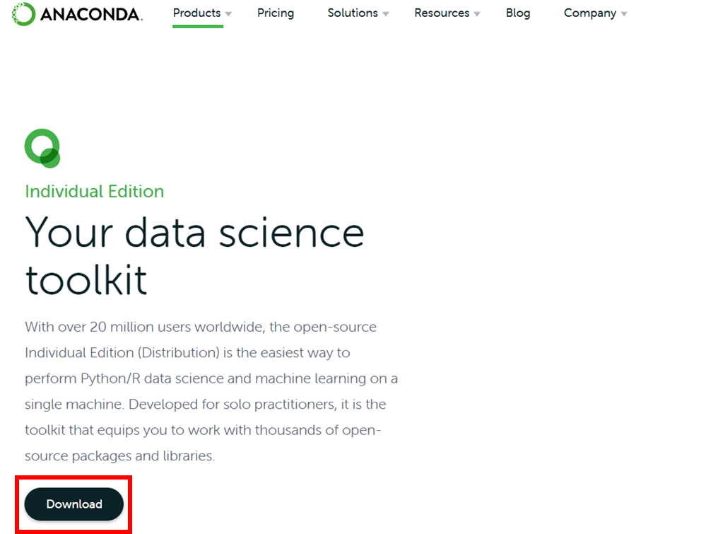
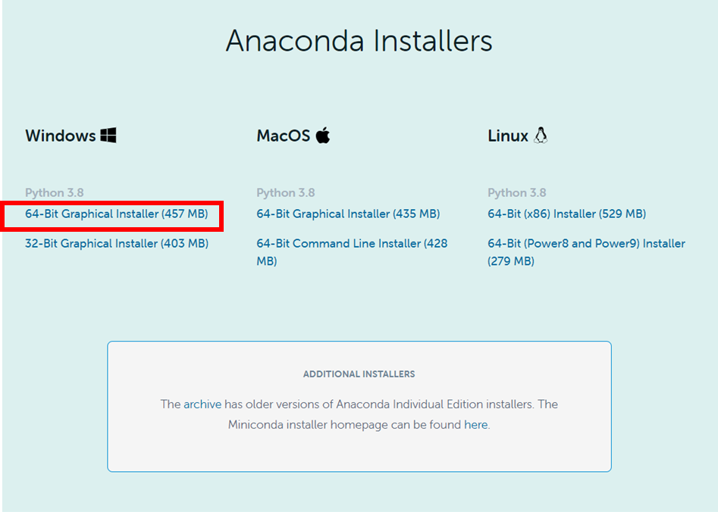
Download
ANACONDA URL: https://www.anaconda.com/products/individual

Slide 5
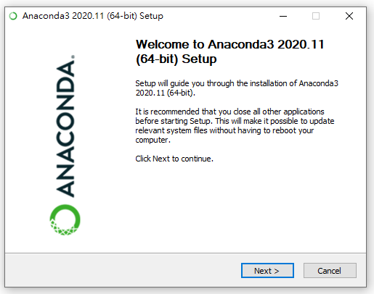
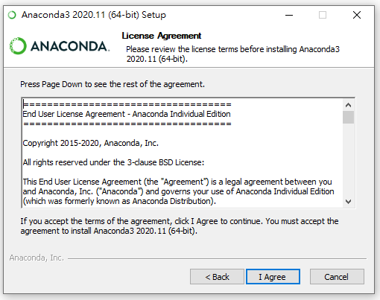
Anaconda3 Setup

Slide 6
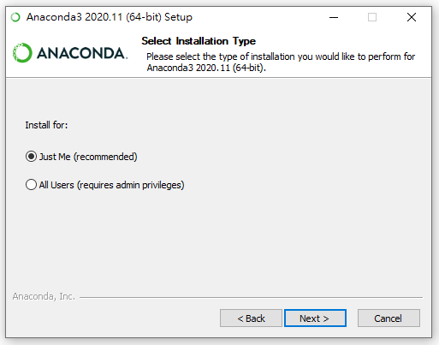
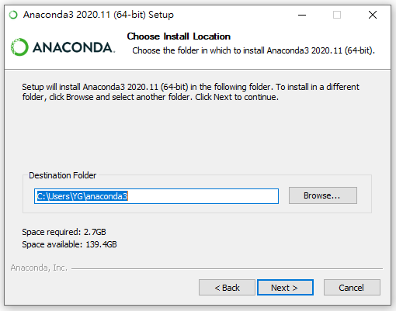
Anaconda3 Setup
your own default path

Slide 7
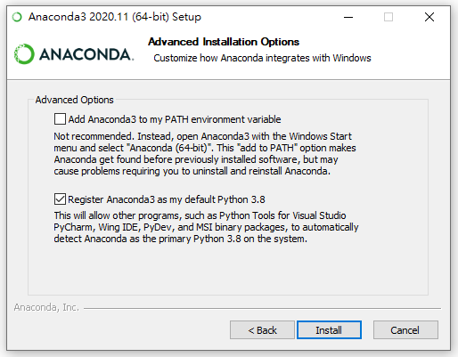
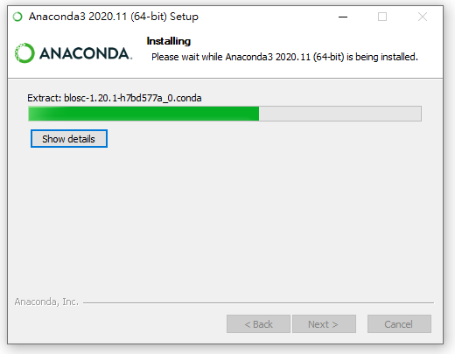
Anaconda3 Setup

Slide 8
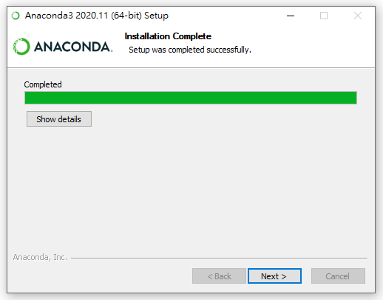
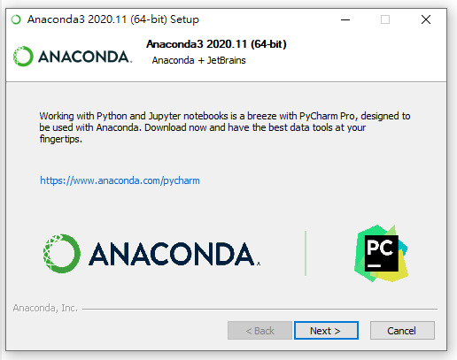
Anaconda3 Setup

Slide 9
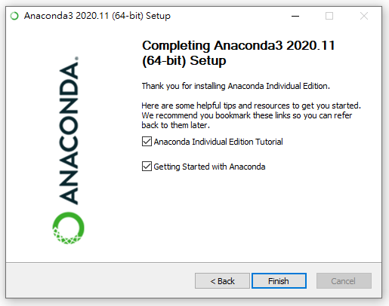
Anaconda3 Setup

Slide 10
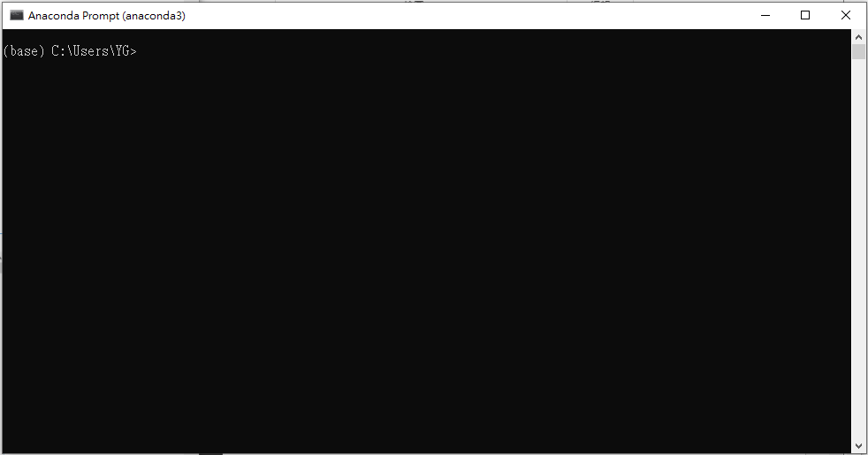
Tensorflow Environment Setup
開始 > Anaconda3 (64-bit) > Anaconda Prompt (anaconda3)

Slide 11
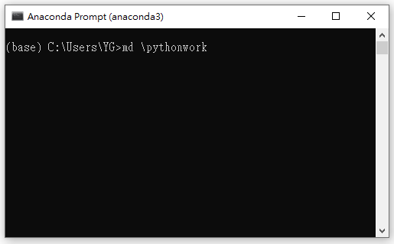
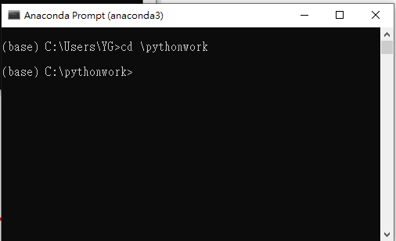
Tensorflow Environment Setup
$ md \pythonwork (建立工作資料夾pythonwork)
$ cd \pythonwork

Slide 12
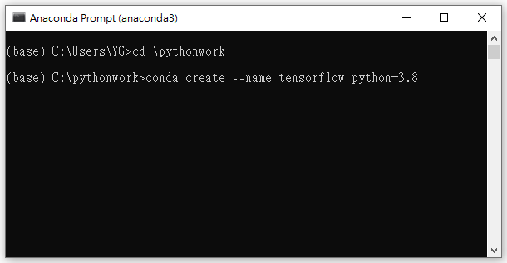
Tensorflow Environment Setup
使用 conda 命令來建立一個命名為 tensorflow 的虛擬環境 並在裡面安裝 Python 3.8 版本
$ conda create --name tensorflow python=3.8
畫面出現“Proceed([y]/n)?”
請按 y 繼續

Slide 13
TensorFlow Environment Setup
啟動剛建立的anaconda虛擬環境
$ conda activate tensorflow
安裝 Tensorflow
$ conda install tensorflow==2.3.0
安裝 Keras
$ conda install –c conda-forge keras==2.2.4
安裝 matplotlib
$ conda install matplotlib
安裝 numpy
$ conda install numpy
安裝 emnist
$ pip install emnist
如果安裝過程遇到問題，可以上網查詢相關強制安裝指令。

Slide 14
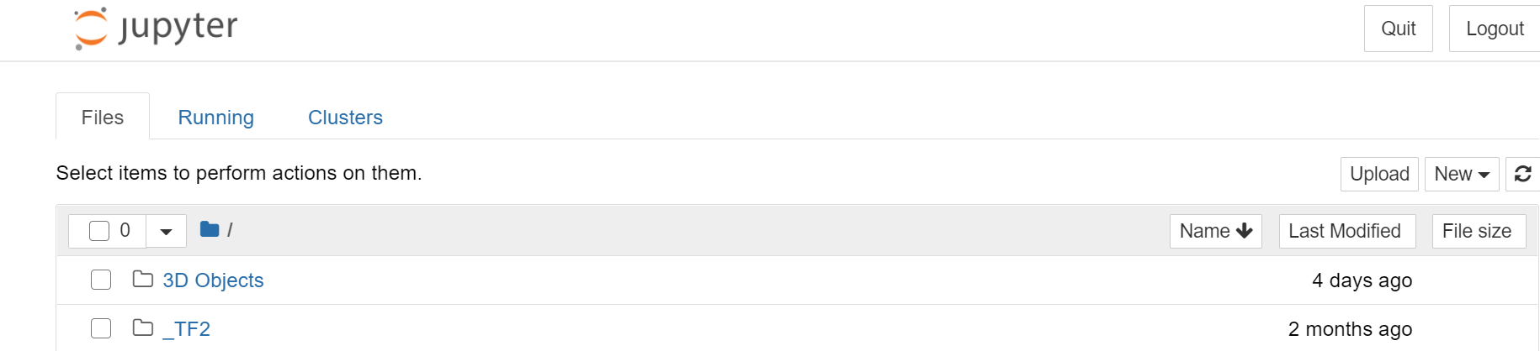
TensorFlow Environment Test
複製資料夾 “C:\workshop\himax_tflm\Synopsys_WEI\Example_Project\Lab5_tflm_conversion_tutorial” 到資料夾 “C:\Users\{username}\” (Jupyter Notebook預設路徑)
開始 > Aanaconda3 (64-bit) > Jupyter Notebook (tensorflow)

Slide 15
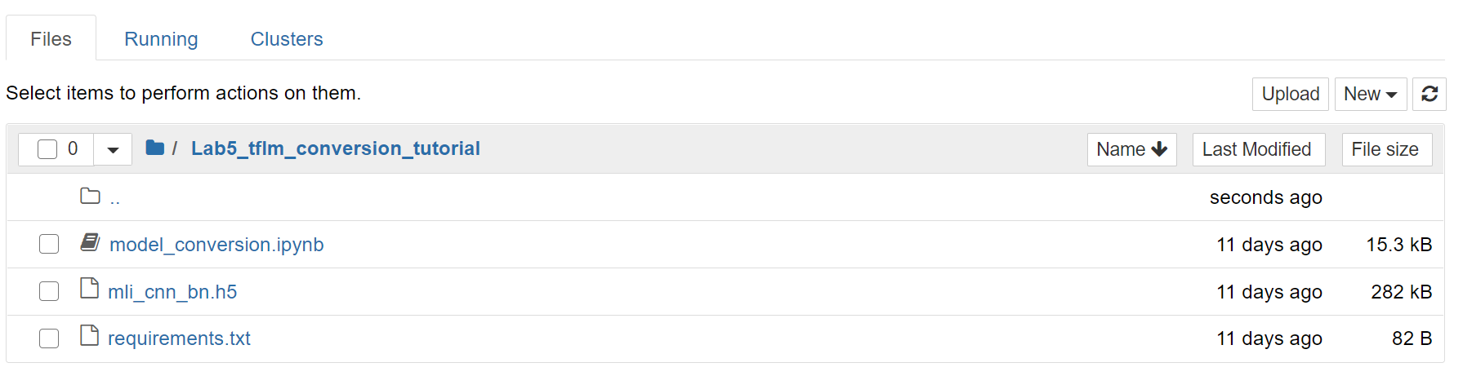
TensorFlow Environment Test
回到 Jupyter Notebook
點選資料夾 Lab5_tflm_conversion_tutorial
開啟 model_conversion.ipynb

Slide 16
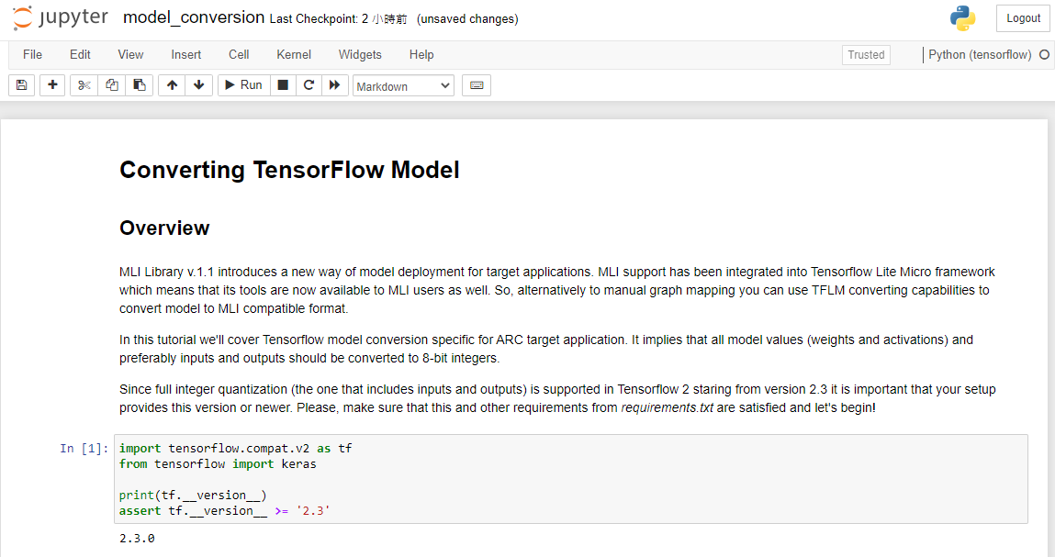
TensorFlow Environment Test
請先確認紅框內是否顯示Python (tensorflow)，且()中的環境是否正確

Slide 17
TensorFlow Environment Test
若執行過程有錯誤，請確認下列module是否有安裝，或版本正確。 Numpy>=1.16.4 matplotlibjupyterlab>=1.1.0 tensorflow==2.3.0 keras>=2.2.4 emnist

Slide 18
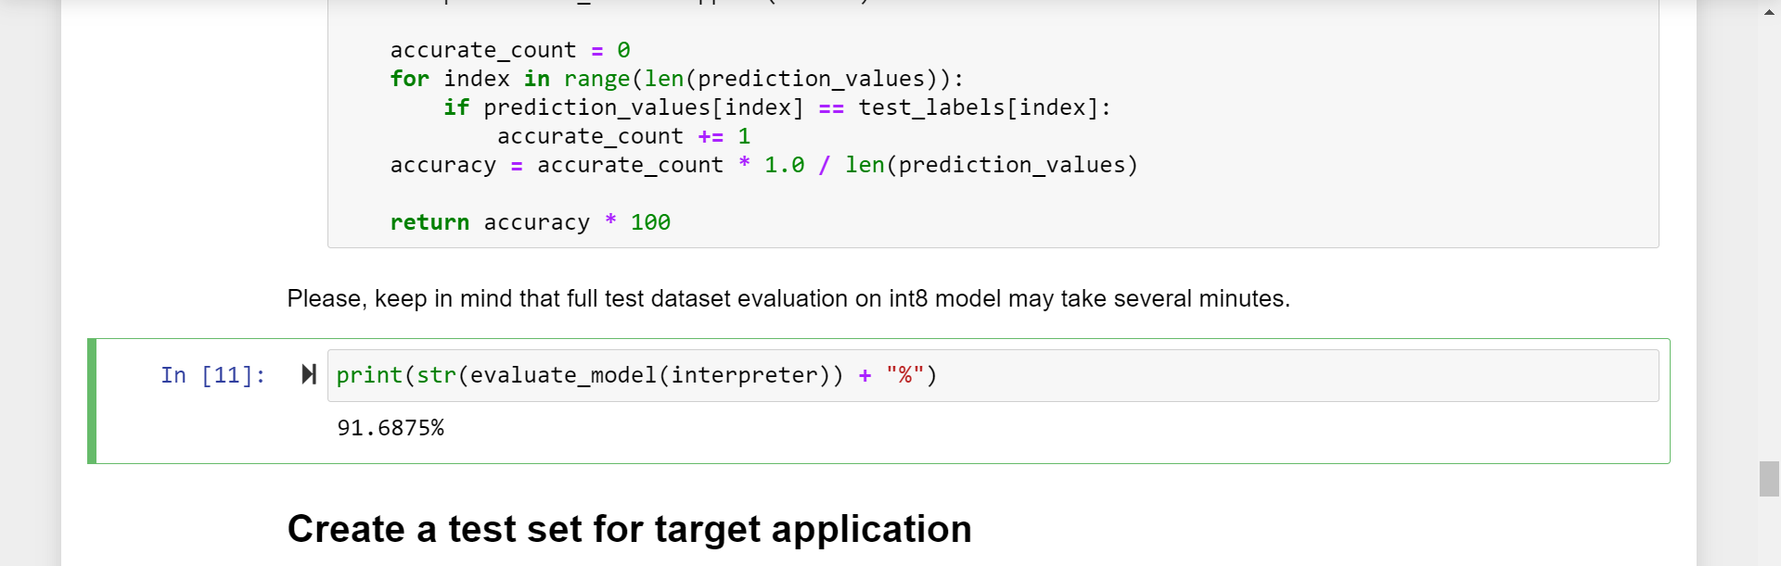
TensorFlow Environment Test
evaluate_model會執行較久，請耐心等候 You can see your model accuracy about 91.6875%

Slide 19
TensorFlow Environment Test
執行完成後，回到Lab5_tflm_conversion_tutorial資料夾 會產生generated/emnist_model_int8.tflite與test_samples.cc 代表TensorFlow開發環境已經安裝完成 Lab5_tflm_conversion_tutorial | ----mli_cnn_bn.h5 ----model_conversion.ipynb ----requirements.txt ----generated | ---- emnist_model_int8.tflite ---- test_samples.cc

Slide 20
TensorFlow Environment Test
開啟Cygwin，並移動到Lab5_tflm_conversion_tutorial/generated $ cd c: $ cd Users/{username}/ (Jupyter Notebook Path) $ cd Lab5_tflm_conversion_tutorial/generated/
Convert tflite to C model $ cd Lab5_tflm_conversion_tutorial/generated/ $ xxd -i emnist_model_int8.tflite > model.h
You will see your TensorFlow model file model.h
Integrate model.h and test_samples.cc to your WE-I project (Later tutorial)

